Slide 1

HACKATHON PROJECT
HSante
AI-Powered Medical Intake Automation
From Any Input to a Filled DxCare Form in Seconds
AI-Driven
Instant
Reliable

Slide 2
The Challenge
The Problem: Slow Hospital Intake
Time-Consuming Process
Clinicians manually transcribe patient information from multiple sources into DxCare forms — a repetitive task that consumes valuable care time.
The Reality
Error-Prone Workflow
Handwritten notes
Manual data entry increases risk of transcription errors, potentially affecting patient care and creating compliance issues.
Scanned documents
Voice recordings
Reduced Care Time
Conversations
Administrative burden takes time away from direct patient interaction, impacting quality of care and clinician satisfaction.
→ All manually entered into DxCare forms

Slide 3
The Innovation
The Solution: HSante
Transform Any Input into Structured Data
AI-powered extraction and automated form filling
5
<5s
100%
Input Modes
Form Filling
Automated
Accept Any Input
How It Works
1
Extract
LLMs parse unstructured data
Text
Photos
PDFs
2
Structure
Map to DxCare form fields
Spreadsheets
Voice
Chat
3
Automate
Fill forms via desktop automation

Slide 4
Flexibility
Five Input Modes
Seamlessly capture patient information from any source, any format
Chat
Text
Camera
Upload
Voice
AI-guided conversation with patient/doctor modes
Paste clinical notes, referral letters, freeform text
Snap prescriptions, lab reports, handwritten notes
Drag & drop images, PDFs, spreadsheets, JSON
Record verbal descriptions, auto-transcribe & parse
TTS
Voice
One-shot
Vision AI
Multi-format
STT
Any Source
Any Format
Same Result

Slide 5
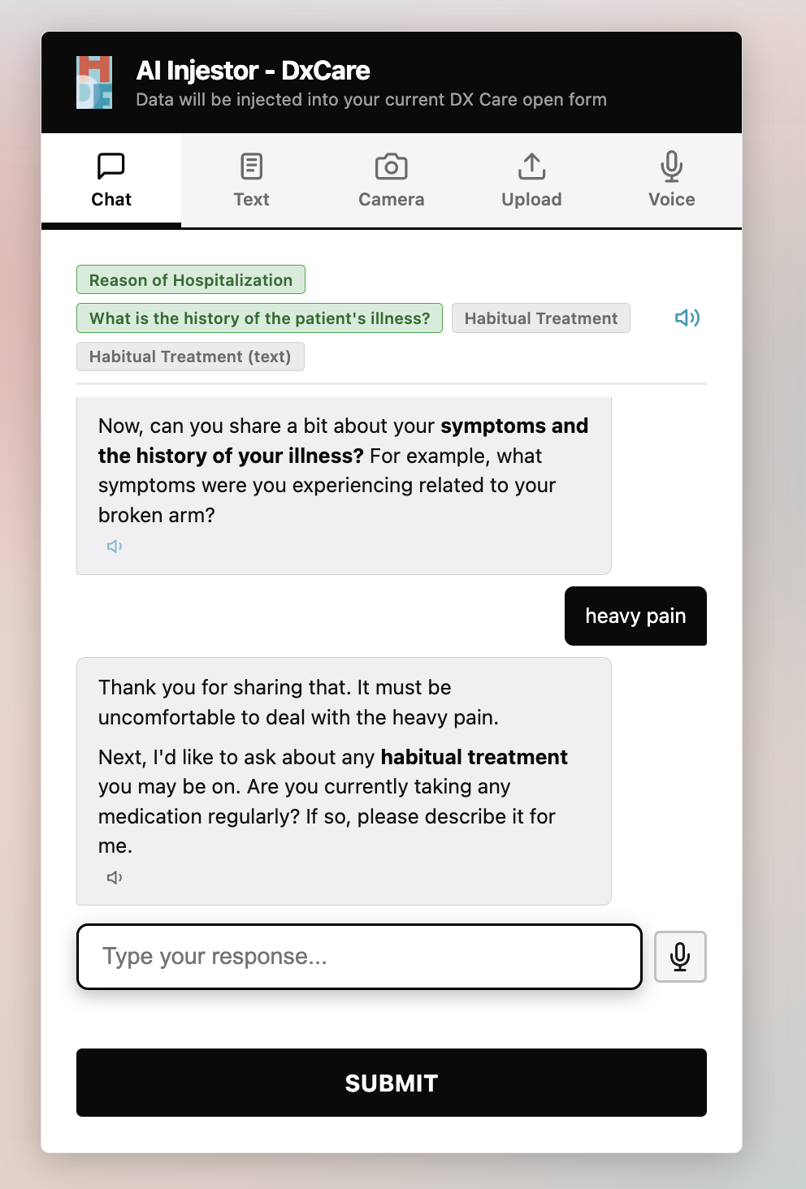
Flagship Feature
Chat Mode: Conversational Data Collection
Adaptive AI Assistant
Patient Mode
Doctor Mode
Friendly, empathetic tone with simple, accessible language
Professional, concise communication using medical terminology
Key Features
Field Progress Pills
Real-time visual indicators showing collected (green) and pending (gray) data
Token Streaming
AI responses stream token-by-token for natural conversation flow
Text-to-Speech
Every response read aloud with convenient mute toggle
Voice Input
Tap mic button for hands-free voice responses

Slide 6
Versatility
Additional Input Modes
Text Mode
Upload Mode
Paste & Parse
Drag & Drop Files
Paste clinical notes, referral letters, or any freeform text. The LLM extracts all relevant fields in one shot.
Drag and drop or browse for files. Supports multiple formats for maximum flexibility.
Supported Content:
Supported Formats:
Clinical Notes
Referrals
Freeform Text
PNG, JPG, WEBP, GIF, BMP
PDF (multi-page)
CSV, Excel (.xlsx, .xls)
JSON
Camera Mode
Snap a Document
Voice Mode
Point your phone camera at prescriptions, lab reports, or handwritten notes. Vision AI extracts structured data.
Record & Transcribe
Hit record, describe patient context verbally. Live timer and animated visualizer provide real-time feedback.
Vision Model:
Gemini 2.5 Pro
Speech-to-Text:
Deepgram Nova-3

Slide 7
Transparency
Smart Extraction with Reasoning
Results Card Interface
Reason of Hospitalization
Explainable AI
Chest pain, shortness of breath
Every extraction shows what was extracted and why
Reasoning:
"Patient mentioned experiencing chest pain and difficulty breathing for the past 2 days..."
What
The extracted field values
Current Medications
Metformin 500mg, Lisinopril 10mg
Why
Allergies
Chain-of-thought reasoning
Penicillin, Shellfish
Edit Fields
Confirm
Human Verification
All extracted fields are editable before confirmation, ensuring accuracy and maintaining clinician oversight.
Trust Through Transparency
Expandable reasoning sections build clinician confidence in AI-generated extractions.

Slide 8
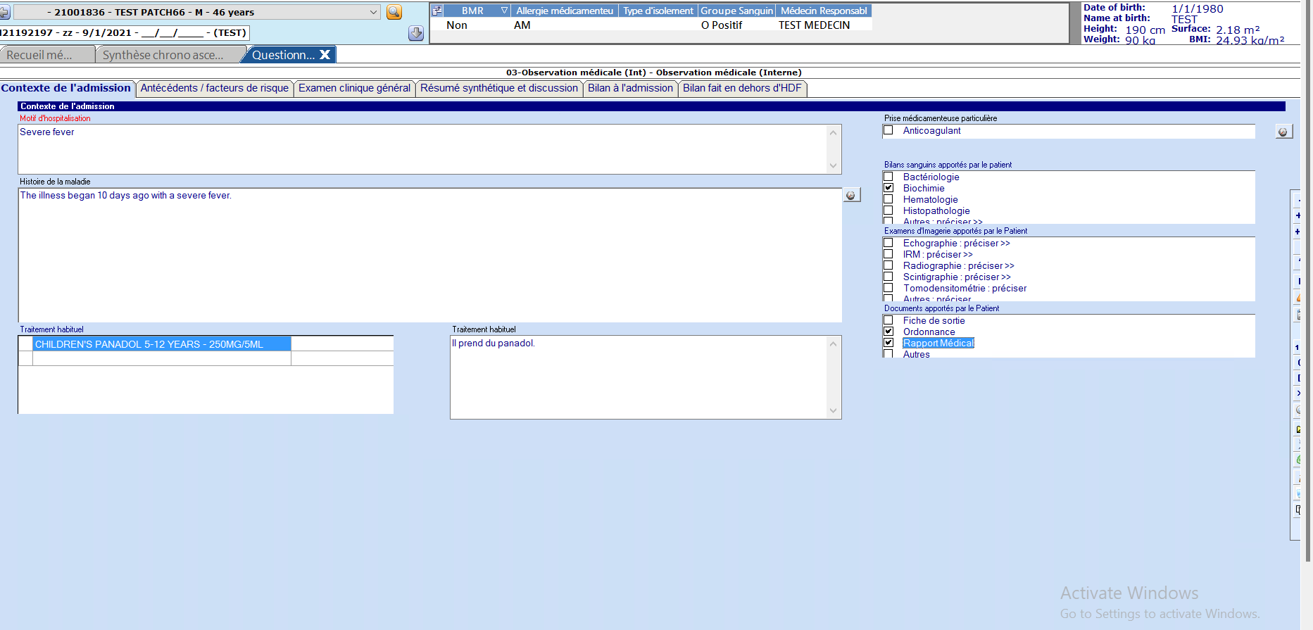
Automation
One-Click Form Filling
DxCare Form Filling
Seamless Automation
From confirmation to completed form in seconds
1
Confirm Data
Review and approve extracted fields
2
Click Fill
HSante switches to DxCare window
3
Done
All fields auto-populated
Desktop Automation
Powered by PyAutoGUI — programmatically controls mouse and keyboard to interact with DxCare.
<5s
100%
0
Text Inputs
Dropdowns
Checkboxes
Form Completion
Fields Filled
Manual Clicks

Slide 9
Core Innovation
How Form Filling Works
Decoupling data from coordinates through a two-file system
The Core Trick
We separate what data the form needs from where to click on screen using a two-file system.
DxCare Form
questionaire.json
AI Extraction
Form Filler
Desktop application with fields to fill
Form definition with coordinates
LLM parses input against schema
PyAutoGUI clicks and types
x, y coordinates
Structured data
Click at x,y
Needs mapping
Field types
{field: value}
Type value
questionaire.json
questionaire_schema.json
Form definition with pixel coordinates. Map each DxCare field once.
Auto-generated schema without coordinates. This is what the LLM sees.
form_input
searchable_select
checkbox_group
Fields only
No coordinates

Slide 10
System Design
Technical Architecture
Frontend
Backend
External Services
Vanilla JS with 5 input modes, Markdown rendering, TTS playback
Flask (Python) with parser router directing to specialized AI models
OpenRouter, Deepgram, Cloudflare R2 for AI and storage
Vanilla JS
CSS
Flask
Python
OpenRouter
Deepgram
Backend Parser Router
Text
Image
Audio
PDF
CSV/XLS
DSPy + GPT-OSS
DSPy + Gemini 2.5
Deepgram STT
PyMuPDF → Image
Pandas → Text
/chat-*
/tts /stt
/fill-form
SSE streaming (GPT-4o)
Deepgram TTS/STT
PyAutoGUI automation
Modular Design
Specialized Parsers
Real-time Streaming

Slide 11
Implementation
Technology Stack
Core
AI Models
Voice
Backend
Flask (Python)
Chat
GPT-4o-mini
STT
Deepgram Nova-3
Frontend
Vanilla JS, CSS
Text
GPT-OSS-120B
TTS
Deepgram Aura-2
Orchestration
DSPy
Vision
Gemini 2.5 Pro
Provider
Deepgram
File Processing
Automation
Getting Started
PDF
PyMuPDF
Form Filling
PyAutoGUI
pip install -r requirements.txt
Spreadsheets
Pandas
Storage
Cloudflare R2
cp .env.example .env
python app.py
Excel
openpyxl
AI Gateway
OpenRouter
Open localhost:5000/form-context

Slide 12
HACKATHON PROJECT
Built at a Hackathon — Because Clinicians Deserve Better Tools
HSante transforms medical intake from a time-consuming manual process into an automated, intelligent workflow. By leveraging AI to handle data extraction and form filling, clinicians can focus on what matters most: providing quality patient care.
Minutes → Seconds
Zero Errors
More Care Time
AI-powered accuracy
Form completion time
Focus on patients
charbeltabet/hdf-hacksante
Open Source

